Slide 1

Healthcare Analytics for Doctor Visits_TIRTC
Devpal Singh Anand
Amity University Online, Noida
AICTE STU ID : STU658299becb6581703057854

Slide 2

PROBLEM STATEMENT
A single average of doctor visits can hide differences in healthcare utilization across patient groups. This project analyzes 5,190 patient records to examine how doctor visits vary with illness, chronic conditions and health coverage, helping identify patterns that hospital management should investigate before making operational decisions.

Slide 3
Healthcare Analytics for Doctor Visits explores 5,190 patient records to identify patterns in healthcare utilization. Using Python on Google Colab, the analysis covers data cleaning, outlier assessment, univariate, bivariate and multivariate analysis, and statistical testing with Mann–Whitney U, Kruskal–Wallis, chi-square and Spearman correlation. The project concludes with five key findings and data-driven recommendations to support hospital planning.
Project Description

Slide 4

WHO ARE THE END USERS?
Hospital management teams responsible for appointment capacity and staffing.
Healthcare analysts studying patient demand and doctor-visit patterns.
Care-coordination teams managing follow-up for patients with chronic-conditions.

Slide 5

Technology Used
Python — Pandas and NumPy for data cleaning and analysis.
Matplotlib and Seaborn for visualization.
SciPy for statistical testing — Mann-Whitney U, Kruskal-Wallis, chi-square, Spearman correlation.
Google Colab as the analysis environment.

Slide 6
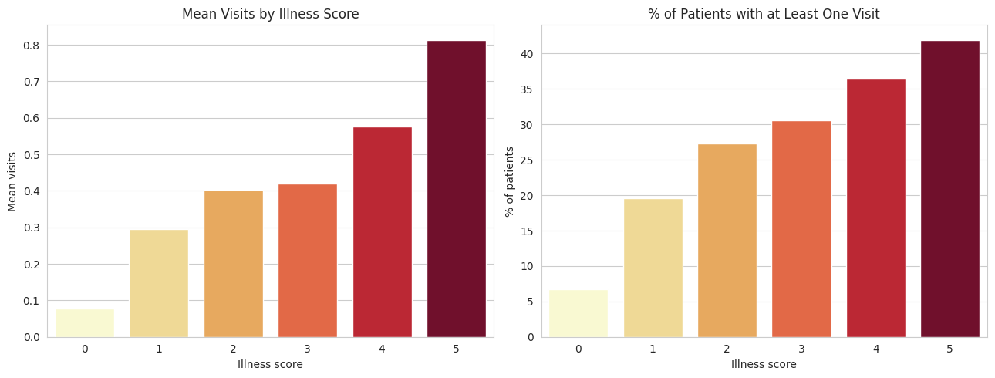
RESULTS
Illness Severity & Visit Frequency
Key Observations:
Illness score: Mean visits rise from 0.08 at a score of 0 to 0.81 at a score of 5, about ten times higher.
Any-visit rate: the share of patients with at least one visit rises from 6.8% at a score of 0 to 41.9% across the same scores.
Overall: Illness score shows a strong association with doctor-visit demand in the dataset.

Slide 7
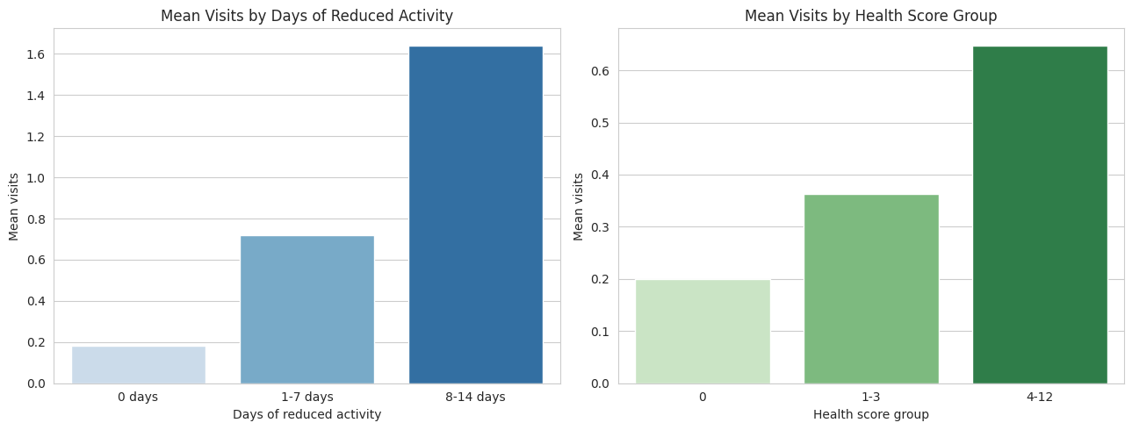
Reduced Activity & Health Score
Key Observations:
Reduced activity: Mean visits rise from 0.18 at 0 days to 1.64 at 8-14 days, about nine times higher.
Health score: Mean visits rise from 0.20 at a score of 0 to 0.65 at a score of 4-12, a smaller but similar climb.
Overall: Days of reduced activity has the strongest observed correlation with doctor visits among the variables analyzed. (Spearman rho (ρ) 0.34).

Slide 8
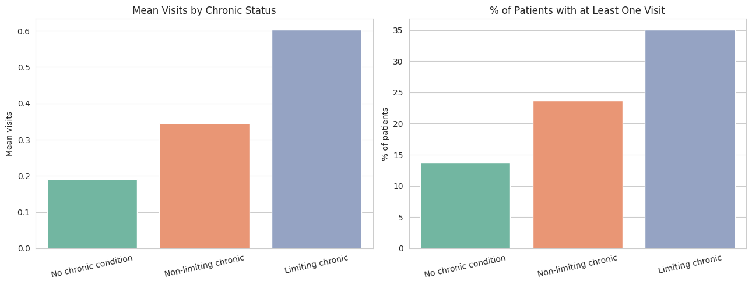
Chronic Condition Impact on Visit Rates
Key Observations:
Mean visits: Patients with a limiting chronic condition average 0.60 visits, compared with 0.19 for those without a chronic condition.
Any-visit rate: 35.0% of the limiting-chronic group had at least one visit, compared with 13.7% without a chronic condition.
Overall: Greater activity limitation is associated with higher doctor-visit demand, with a statistically significant association confirmed by the chi-square test (ρ < 0.001).

Slide 9
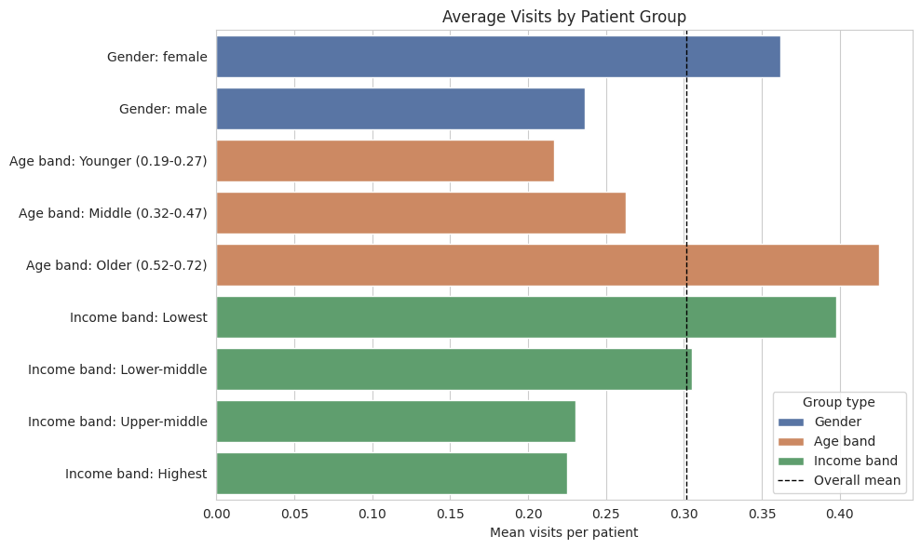
Average Visits by Patient Group
Key Observations:
Age: The older group averages 0.43 visits, compared with 0.22 for the younger group.
Gender: Women average 0.36 visits, compared with 0.24 for men; women that and are older report higher illness level on average.
Income: Mean visits decline from 0.40 in the lowest-income group to 0.22 in the highest-income group.
Overall: Older and lower-income patients, along with women, record more visits on average. Differences in age and illnesses may partly explain these patterns.

Slide 10
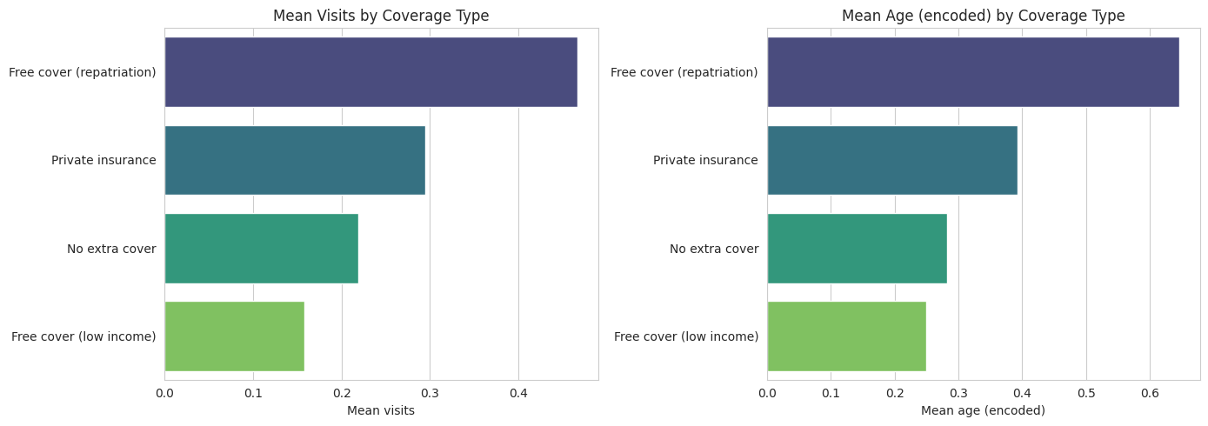
Insurance Coverage and Visit Patterns
Key Observations:
Highest demand: Patients with free coverage through repatriation average 0.47 visits, the highest among coverage groups.
Lowest demand: Patients with free coverage for low income average 0.16 visits, and have the youngest age profile and lowest illness levels.
Overall: Doctor-visit rates vary across coverage groups, but differences in age and illnesses profiles may explain much of the variation; we still cannot say, that the analysis establishes that coverage itself causes these differences.

Slide 11
FUTURE SCOPE
Predictive Modeling: Develop regression or classification models to estimate doctor-visit frequency using illness severity, chronic conditions and demographic factors.
Wait-Time Analysis: Integrate appointment and queue timestamps to investigate waiting times and identify opportunities to improve patient flow.
High-Risk Patient Identification: Develop a model to identify patients who may require frequent visits, supporting proactive follow-up and scheduling.
Coverage & Access Analysis: Examine differences in doctor-visit patterns across coverage groups while accounting for age, illness severity and other relevant factors.
Interactive Dashboard: Build a Power BI or Streamlit dashboard to help hospital management explore patient-demand patterns and support data-informed planning.

Slide 12
CONCLUSION
This project analyzed 5,190 patient records using Python, Pandas, NumPy, Matplotlib and Seaborn to identify patterns in doctor-visit demand. Illness severity and chronic-condition status showed strong associations with visit frequency, while gender showed a smaller difference. Statistical testing supported significant differences across relevant patient groups. These findings can help hospital management plan staffing and appointment capacity, provide healthcare analysts with a reproducible approach to patient-demand analysis, and support care-coordination teams in identifying groups for targeted follow-up. However, the dataset lacks visit timestamps and queue information, so the analysis identifies demand patterns but cannot directly measure or reduce waiting times.

Slide 13
SUBMISSION LINKS:
GitHub Link
Project Submission
Google Colab Link
Devpal_Singh_Charanjeet_Singh_Anand_HealthCare_Analytics_Doctor_Visits_TIRTC.ipynb

Slide 14
Thank you

